Slide 1


Hands on Data science Project 1: Problem Statement 1 Group-A Domain - Water Conservation and Management
BY :
Sameep Shah
Professional Diploma in Data Science - 77422376591

Slide 2
Summary – Approach towards model building
UNDERSTNDING PROBLEM
Checking Correlation
Correlation matrix
Dropping Correlated variable
Number of rows and columns
Data Type
Handling Null Values
Filling null values using MODE
Exploring Data
Correct Approach
Type of Model
Type of Evaluation Model
Target Variable
Features
Null values
Data types of features
Converting Data Type from ‘object’ to ‘category’
Data Analysis
Description of data
Description of Categorical Data
Handling Outliers
Correlation of features with target variable
Splitting Train and Test data and choosing the right model
Analysis of other features
IQR
Z-Score
Description of Continuous Data
Dummy Data and Scaling
Categorize all the categorical variables using the get dummies( )
Scaling the continuous data
Splitting data 70% Train and 30% test
Choosing right model with performance parameter “Accuracy”

Slide 3
What is the objective?
Problem description
The greatest gift that nature has given to us and to all other living things is water. While the majority of us enjoy the luxury of going about our daily lives without experiencing any negative effects from water scarcity, there are those in some regions of the world who must travel long distances just to acquire water. If this access, such as pumps, wells, or other water sources, likewise stops working abruptly, the situation for them gets worse.
Objective of the problem
A machine learning system that can identify the water point that is most likely to fail soon, allowing for the timely redirection of maintenance resources.

Slide 4
EXPLORING DATA
Number of rows and columns
Rows = 44068 Columns = 34
Data Types of Columns
Float = 1 Integer = 6 Object = 27
Columns with Null Values
Public_meeting = 2525 Organization_funding = 2600
Scheme_management = 2930 SchemeName = 20951
Permit = 2227 Company_installed = 2603

Slide 5
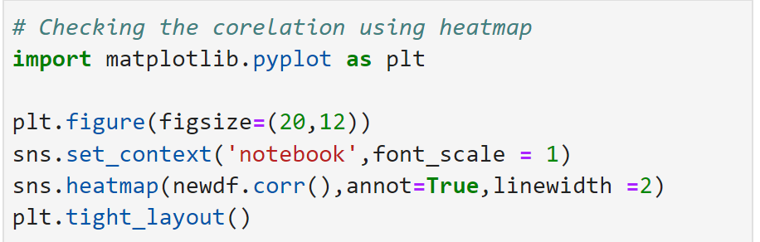
CHECKING CORRELATION
Checking Correlation with Heatmap and dropping the correlated columns using drop( )

Slide 6
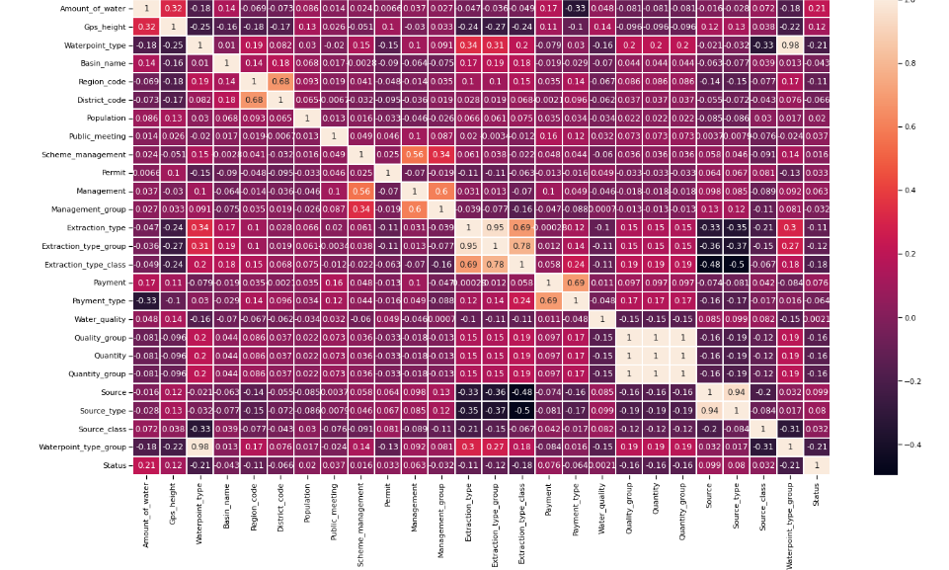

Slide 7
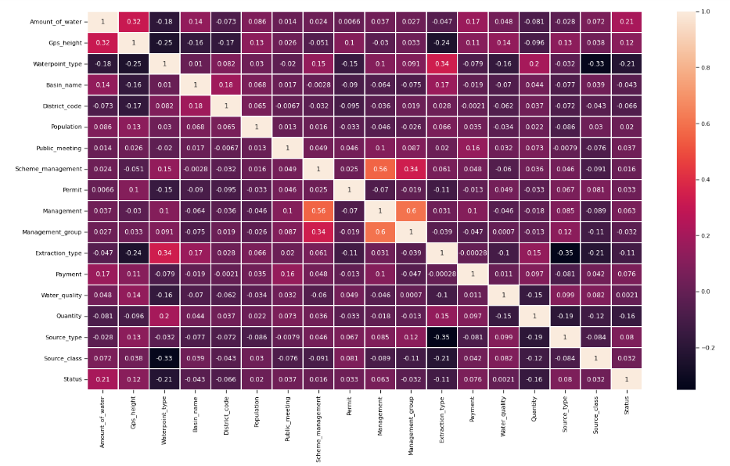

Slide 8
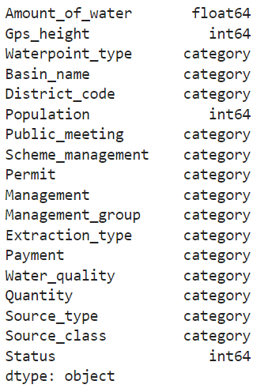
DATA TYPE
Converting ‘object’ datatype to ‘category’
using astype( )

Slide 9
HANDLING NULL VALUES
After dropping features which were highly correlated and features that were not important, we handling null values in the remaining features in our data set.
To handle null values in ‘categorical’ data, we used MODE method to fill the null values with most occurring value in the perticular feature.

Slide 10
DATA ANALYSIS
Analyse data using the following visualization techniques :
HISTOGRAM
BAR PLOT
PIECHART

Slide 11
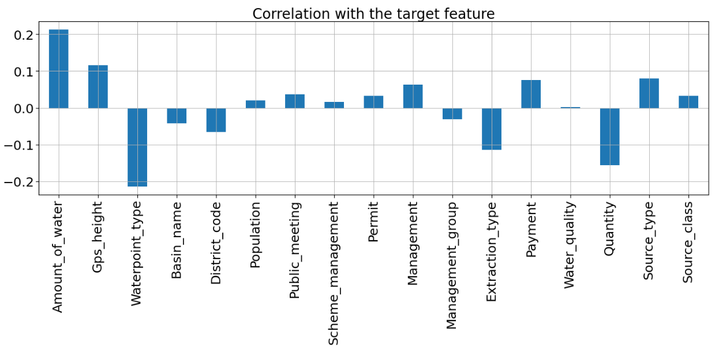
CHECKING CORRELATION OF THE TARGET VARIABLE

Slide 12
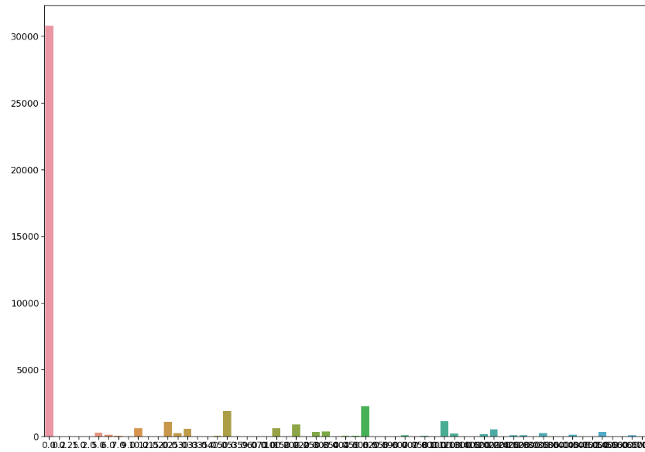
understanding Amount_of_water VARIABLE

Slide 13
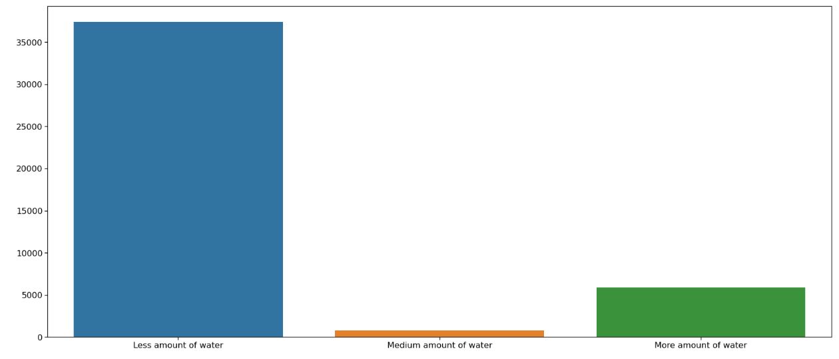
DIVIDING Amount_of_water INTO ‘LESS’, ‘MEDIUM’ & ‘MORE’

Slide 14
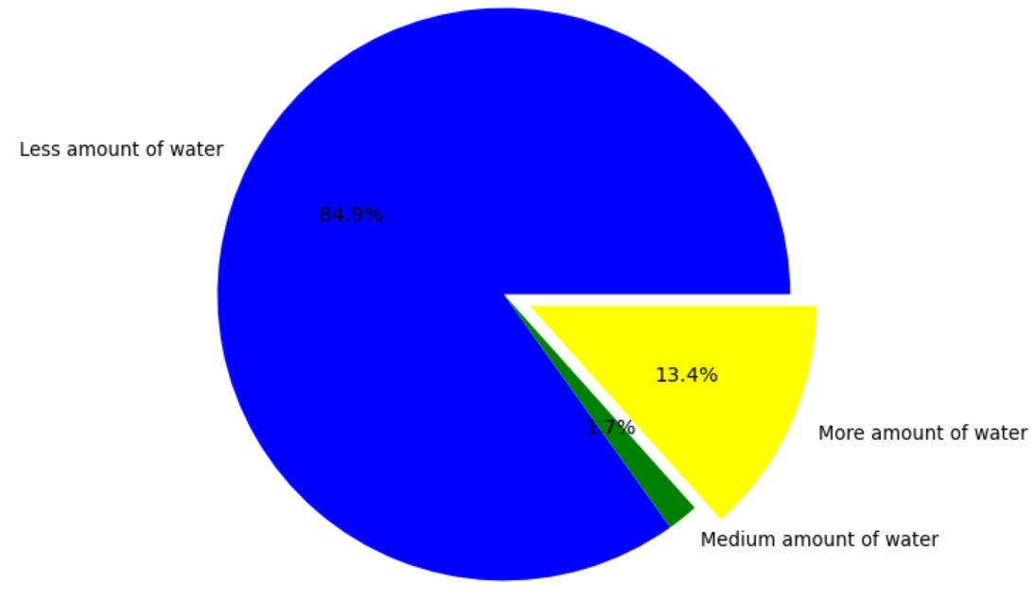
DIVIDING Amount_of_water INTO ‘LESS’, ‘MEDIUM’ & ‘MORE’

Slide 15
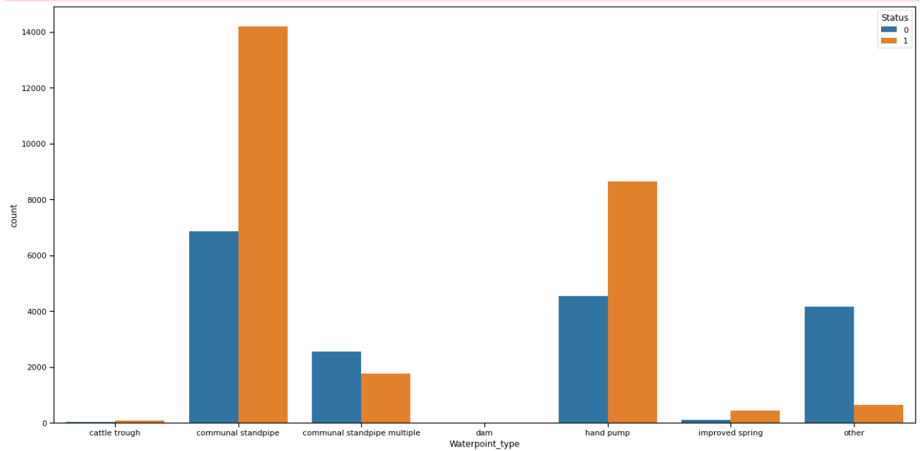
understanding waterpoint_type with target variable status

Slide 16
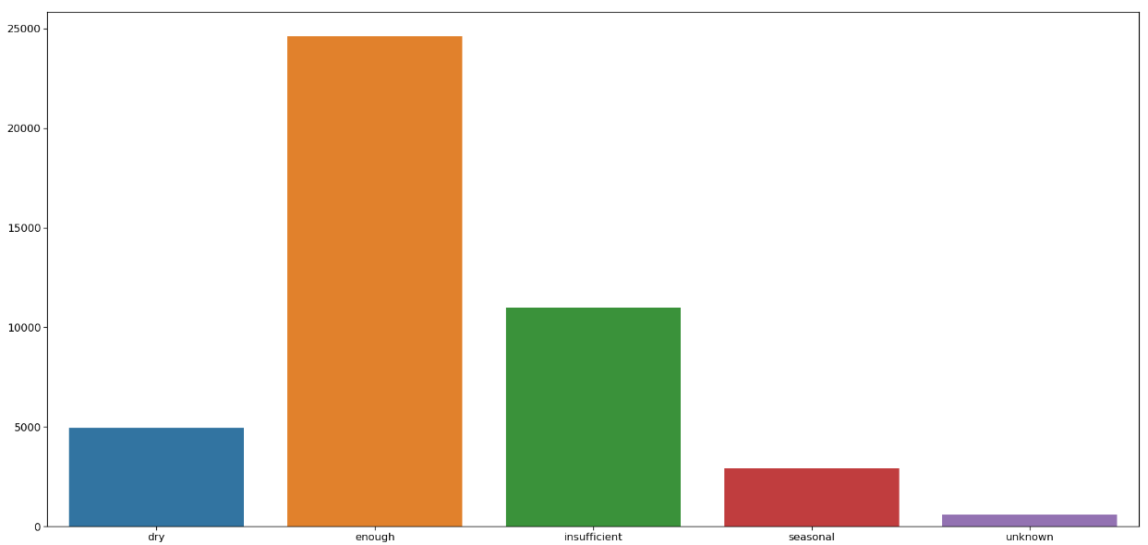
understanding QUANTITY VARIABLE

Slide 17
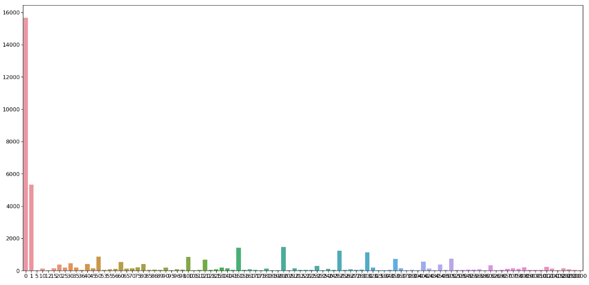
understanding POPULATION VARIABLE

Slide 18
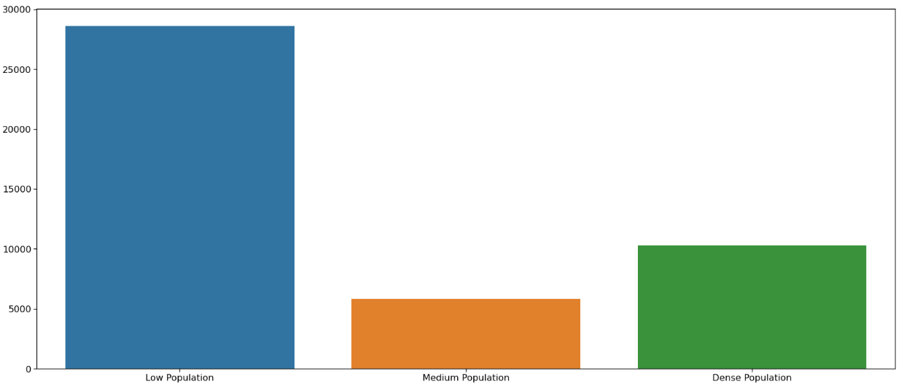
DIVIDING POPULATION INTO ‘LOW’, ‘MEDIUM’ & ‘DENSE’

Slide 19
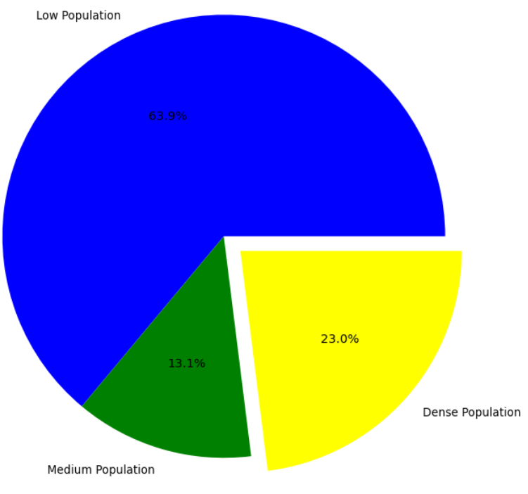
DIVIDING POPULATION INTO ‘LOW’, ‘MEDIUM’ & ‘DENSE’

Slide 20
HANDLING OUTLIERS
Finding the outliers in
Gps_height (int64)
Population (int64)

Slide 21
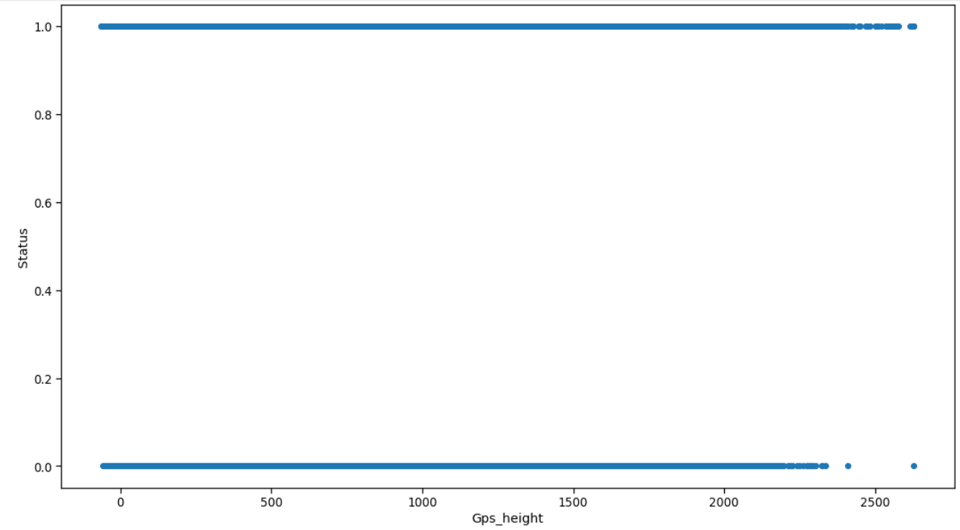
PLOTTING SCATTER PLOT TO DETECT THE OUTLIER IN GPS_HEIGHT

Slide 22
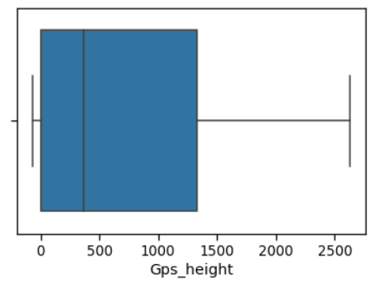
PLOTTING BOX PLOT TO DETECT THE OUTLIER IN GPS_HEIGHT

Slide 23

DETECTING OUTLIERS USING IQR IN GPS_HEIGHT
NO OUTLIERS DETECTED

Slide 24
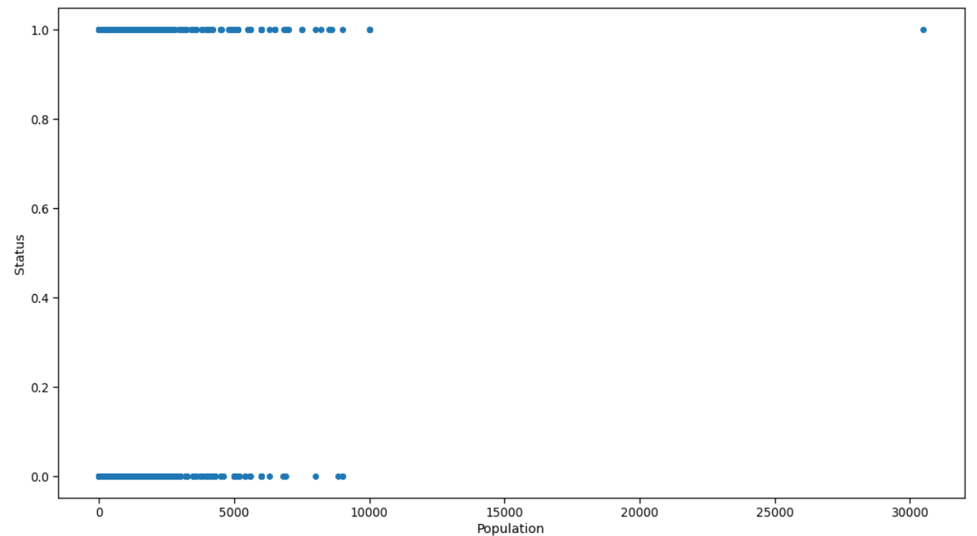
PLOTTING SCATTER PLOT TO DETECT THE OUTLIER IN POPULATION

Slide 25
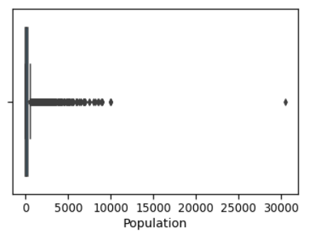
PLOTTING BOX PLOT TO DETECT THE OUTLIER IN POPULATION

Slide 26
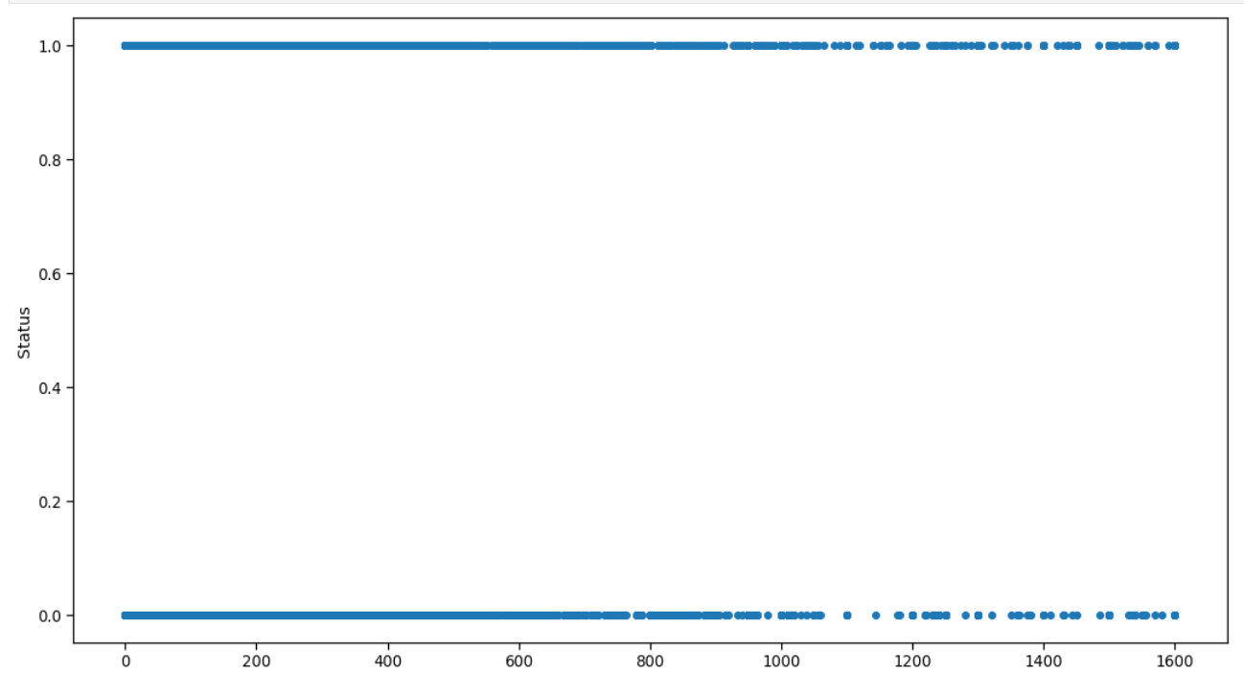
Removed OUTLIER IN POPULATION using z-score

Slide 27
Description of data
Now here first we will be removing the 'Status' column from our set of features
Then we will categorize all the categorical variables using the get dummies method which will create a separate column for each category
Suppose X variable contains 2 types of unique values then it will create 2 different columns for the X variable.

Slide 28
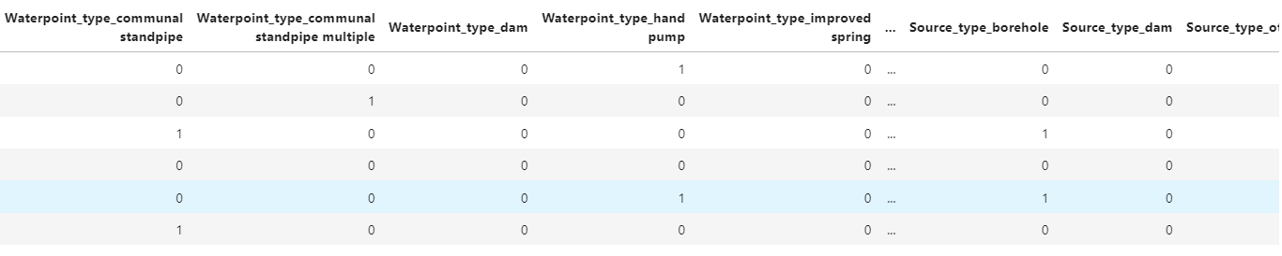
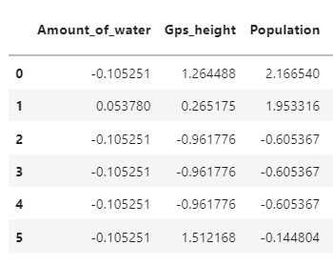
Dummies the categorical values :
Scaling the continuous values :

Slide 29
Splitting train and test data and choosing the model
Splitting the data into TRAIN and TEST by 70% - 30%
Models :
KNN Machine Learning Algorithm
Decision Tree Algorithm
Naive Bayes Algorithm
SVM Algorithm

Slide 30
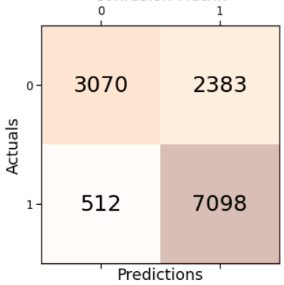
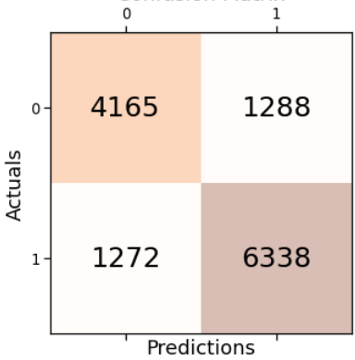
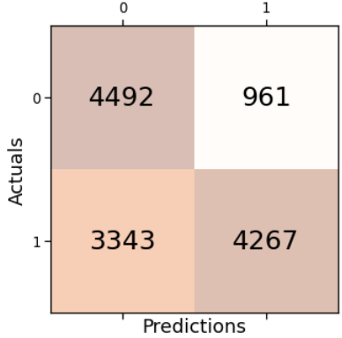
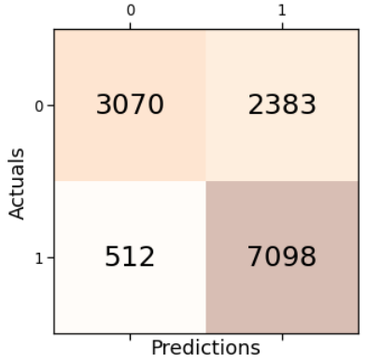
Finalize the best model
MODEL NO | DESCRIPTION | CONUSION MATRIX | PRECISION | RECALL | ACCURACY | F1 SCORE
1 | KNN Machine Learning Algorithm |  | 0.749 | 0.933 | 0.778 | 0.831
2 | Decision Tree Algorithm |  | 0.831 | 0.833 | 0.804 | 0.832
3 | Naive Bayes Algorithm |  | 0.816 | 0.561 | 0.671 | 0.66
4 | SVM Algorithm |  | 0.749 | 0.933 | 0.778 | 0.831

Slide 31
Final deliverables
MODEL 2 - The Decision Tree Algorithm with 0.804 “Accuracy”
Model 1 - KNN Machine Learning Algorithm with 0.933 RECALL

